Slide 1

GitCraft
Crafting Careers One Commit At A Time
By
Bradley Dillion Gilden ~ Sole Developer
03 / 12 / 2023

Slide 2
Table of contents
01
02
03
04
05
06
Introduction
Criteria & inspiration
Technology &
Architecture
Code Snippets
Timeline
Challenges

Slide 3

01
Introduction
Bradley Dillion Gilden
Frontend Development & Design
Backend Development & Design
Testing & Quality Assurance
Documentation

Slide 4
02
Criteria & inspiration
Criteria
The Inspiration
Free Service Delivery & Development
Full Stack Application
Has to be Functional
No Novelties
No Illegal Tools and Resources
GitHub is regularly used by Developers
Allows non-frontend developers to showcase their skills
The GitHub API is Free to use and is produced by GitHub themselves

Slide 5
03
Technology &
Architecture
Backend
Frontend
3rd Party
Flask
mongoDB
Python
JavaScript
HTML
CSS
SCSS
Bootstrap
GitHub API
Chart.js
SweetAlert2

Slide 6


Slide 7
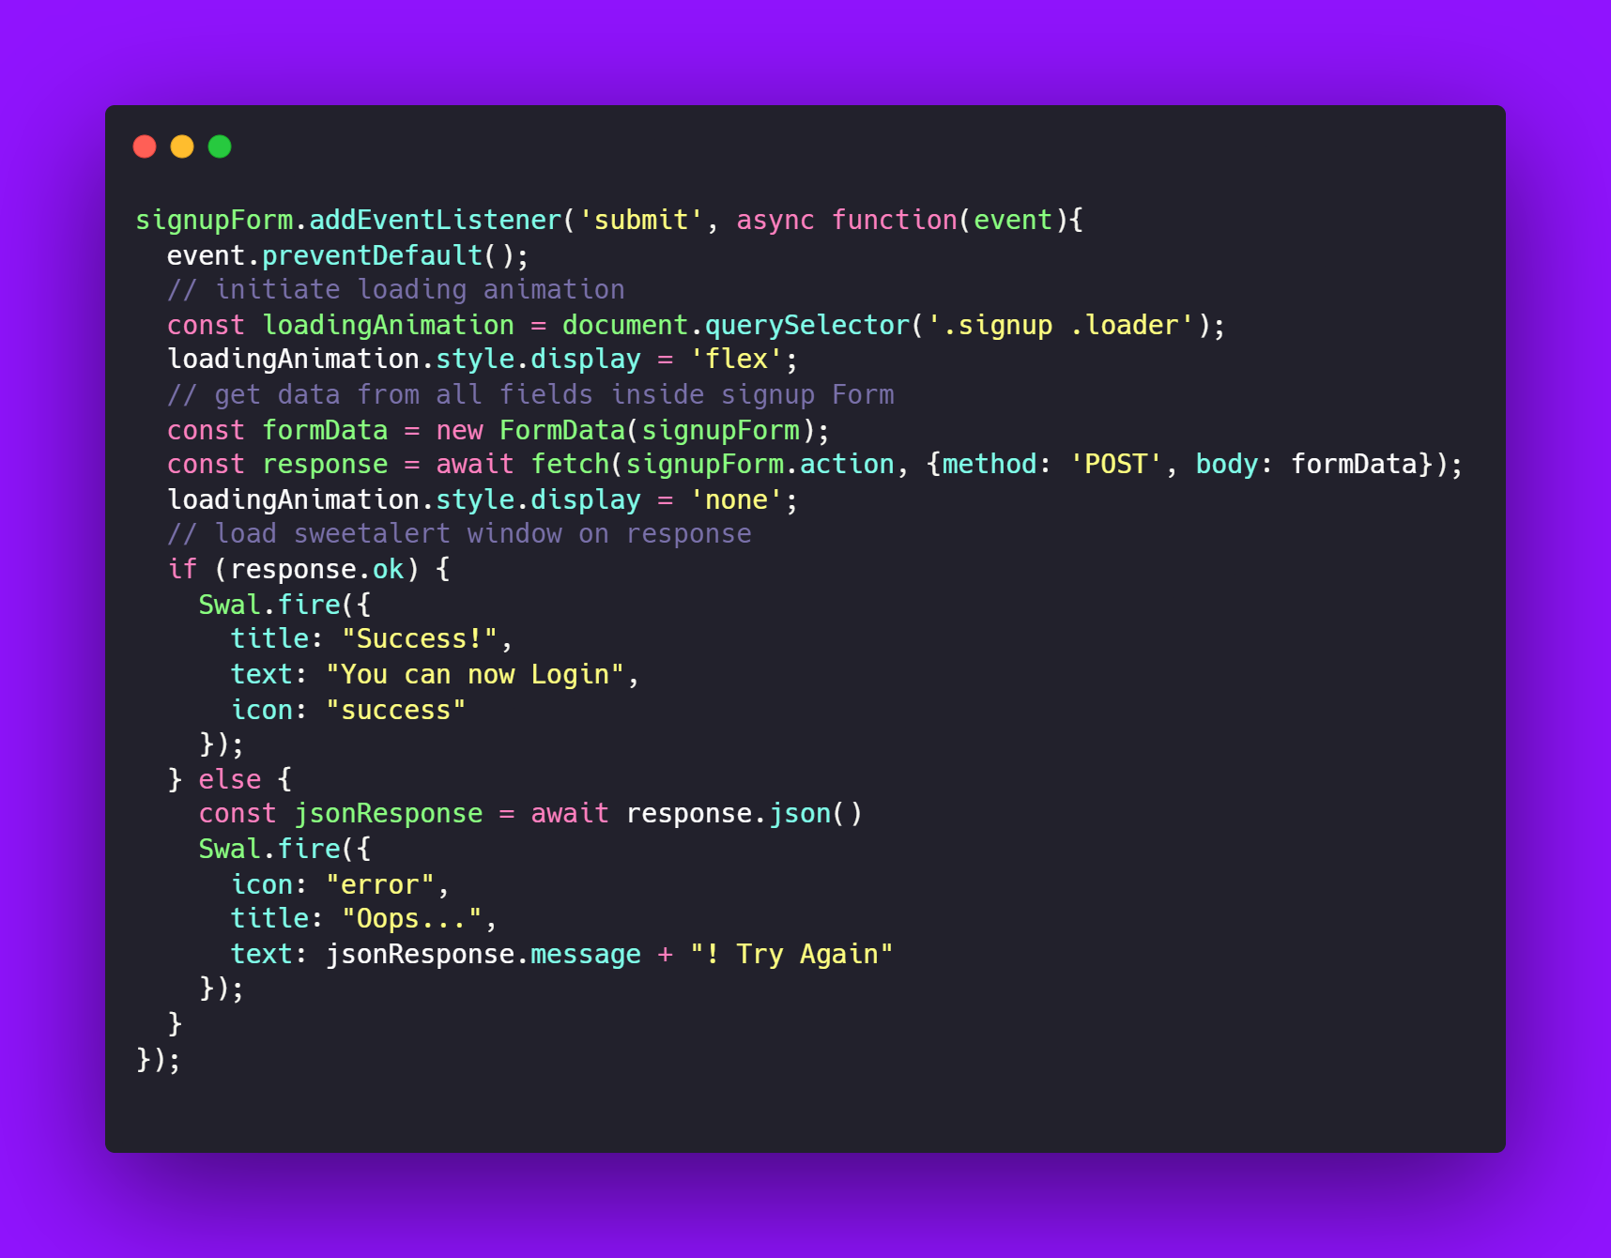
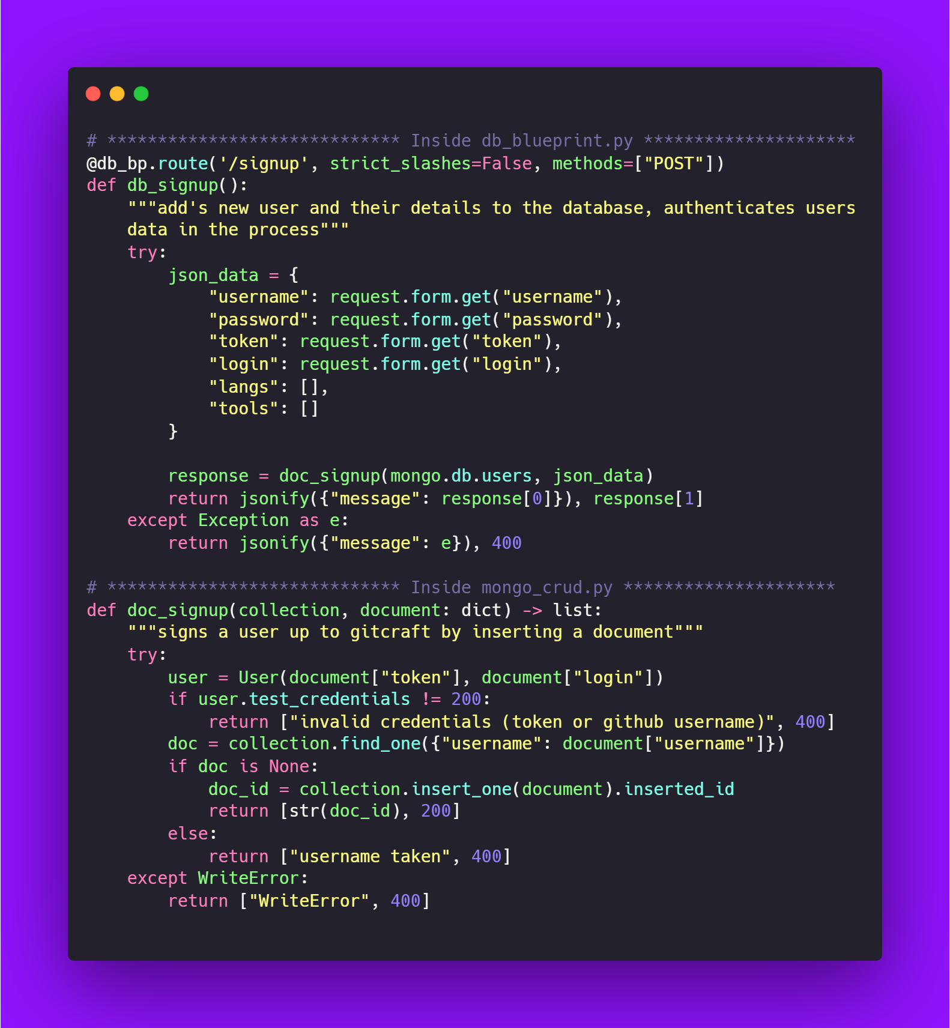
04
Code Snippets
Signup & Login

Slide 8
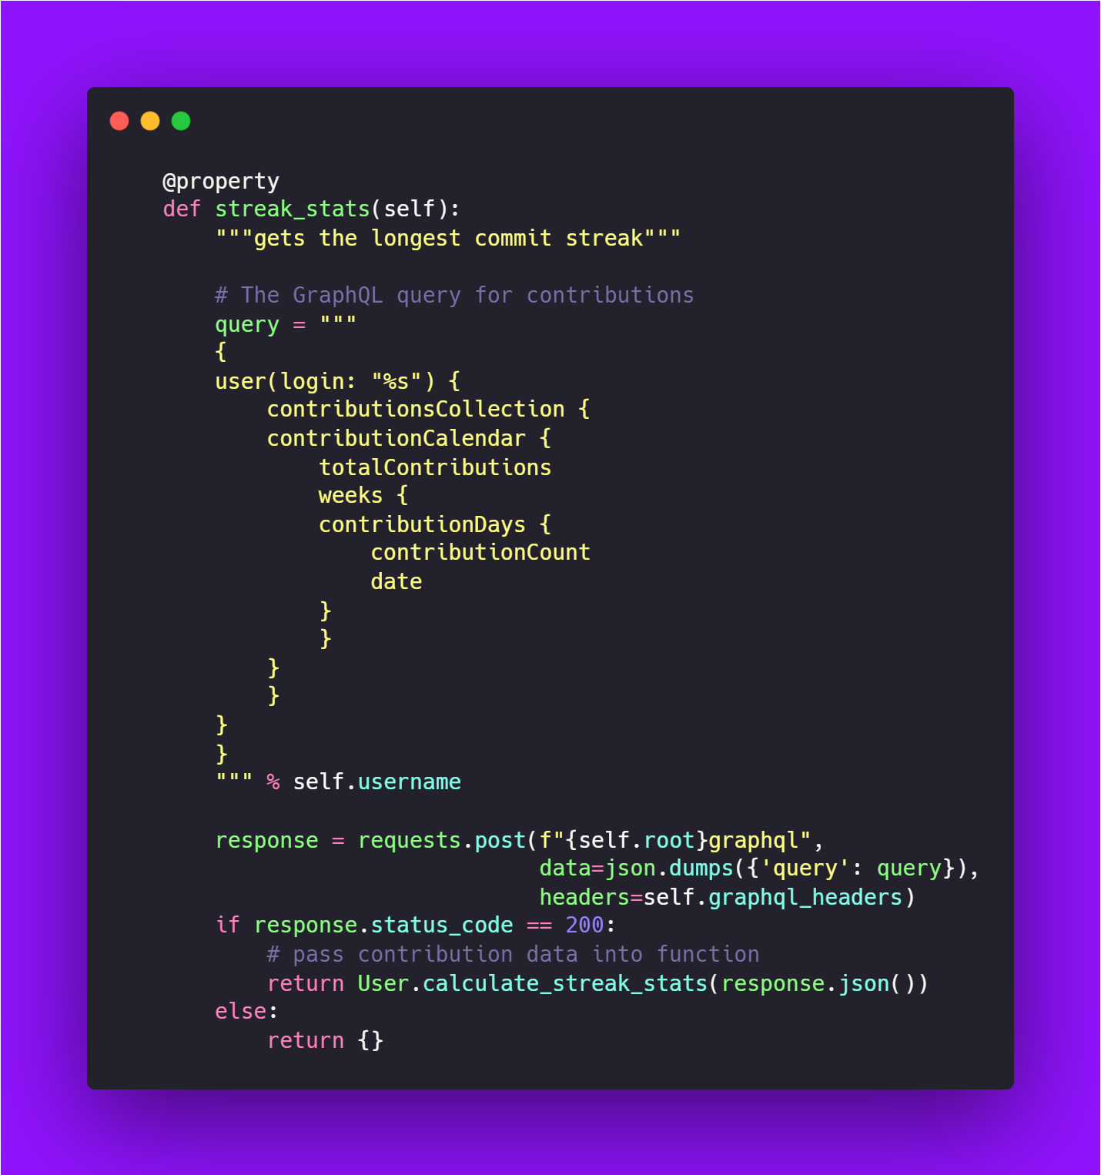
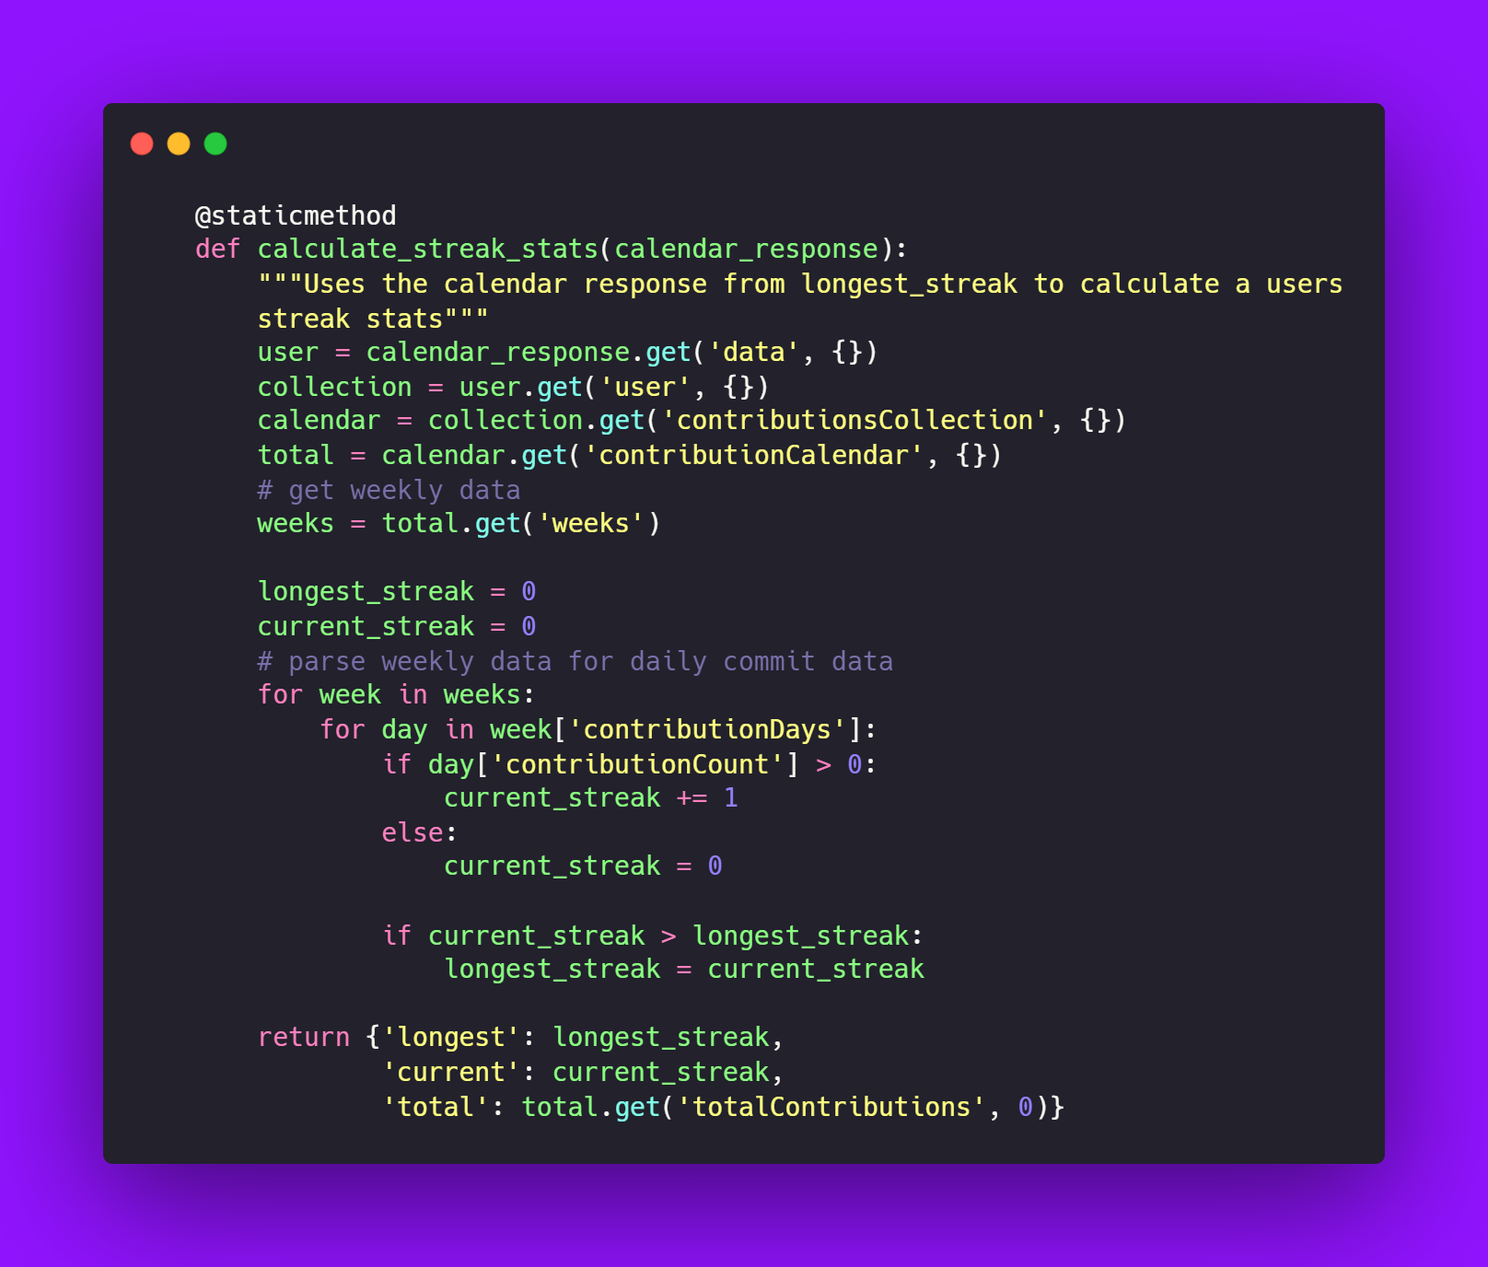
Streak Stats - user.py

Slide 9
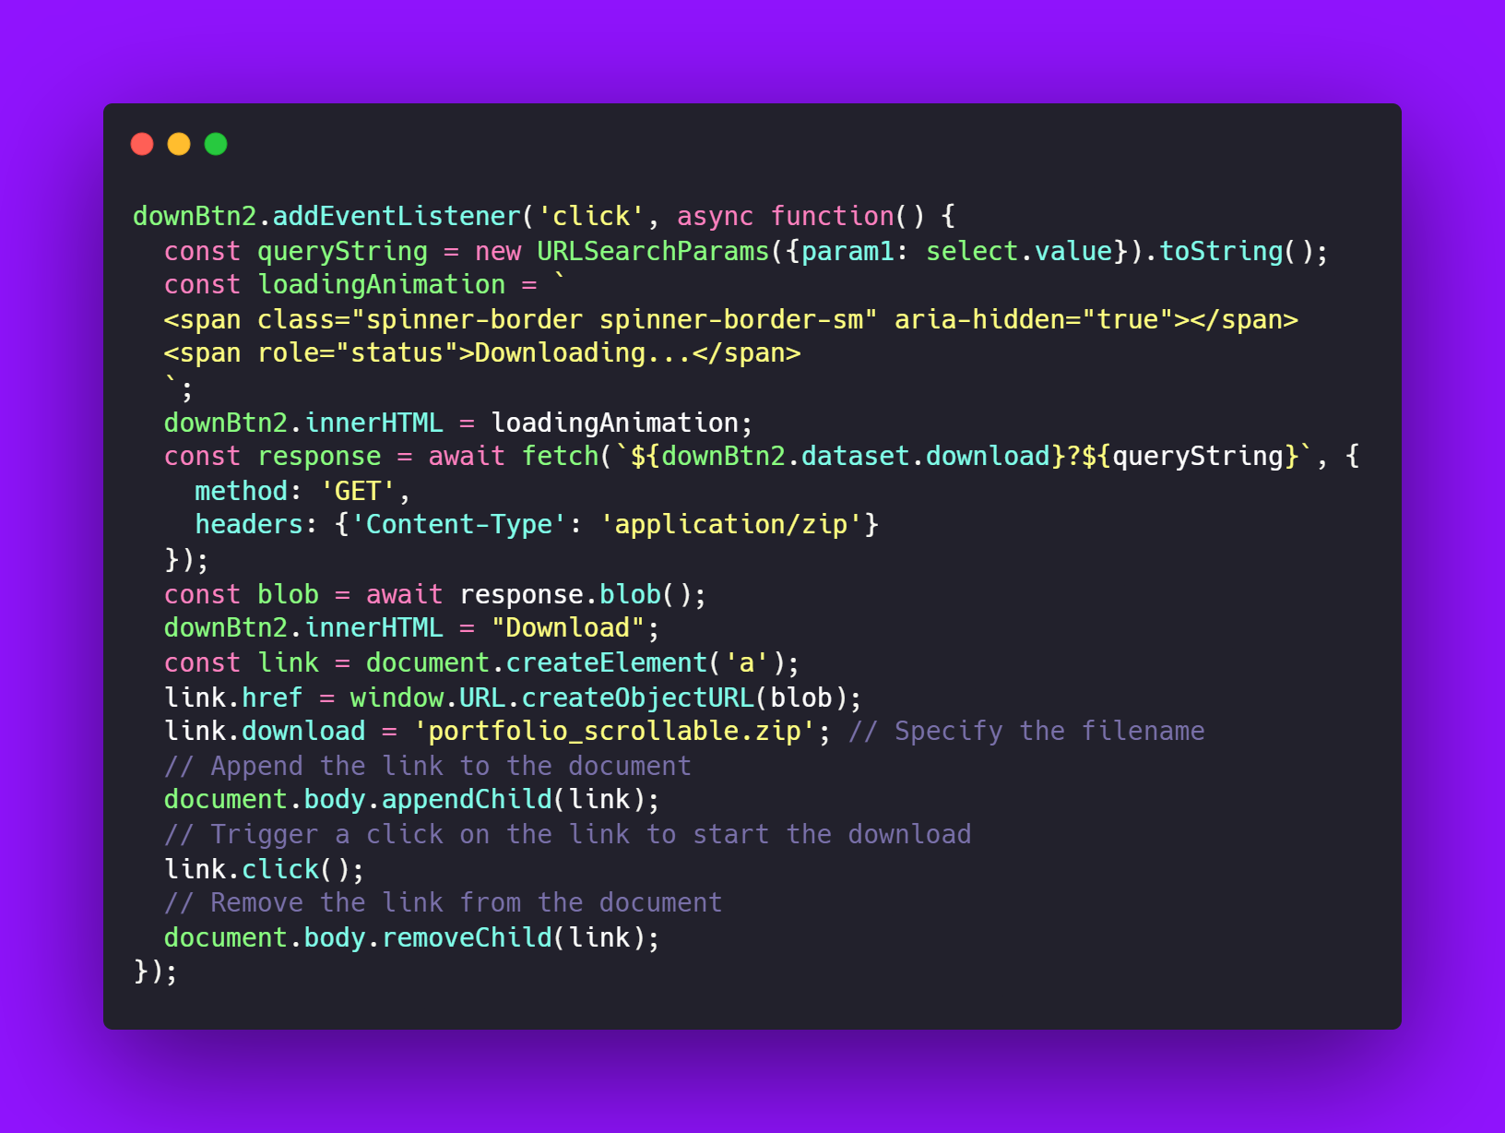
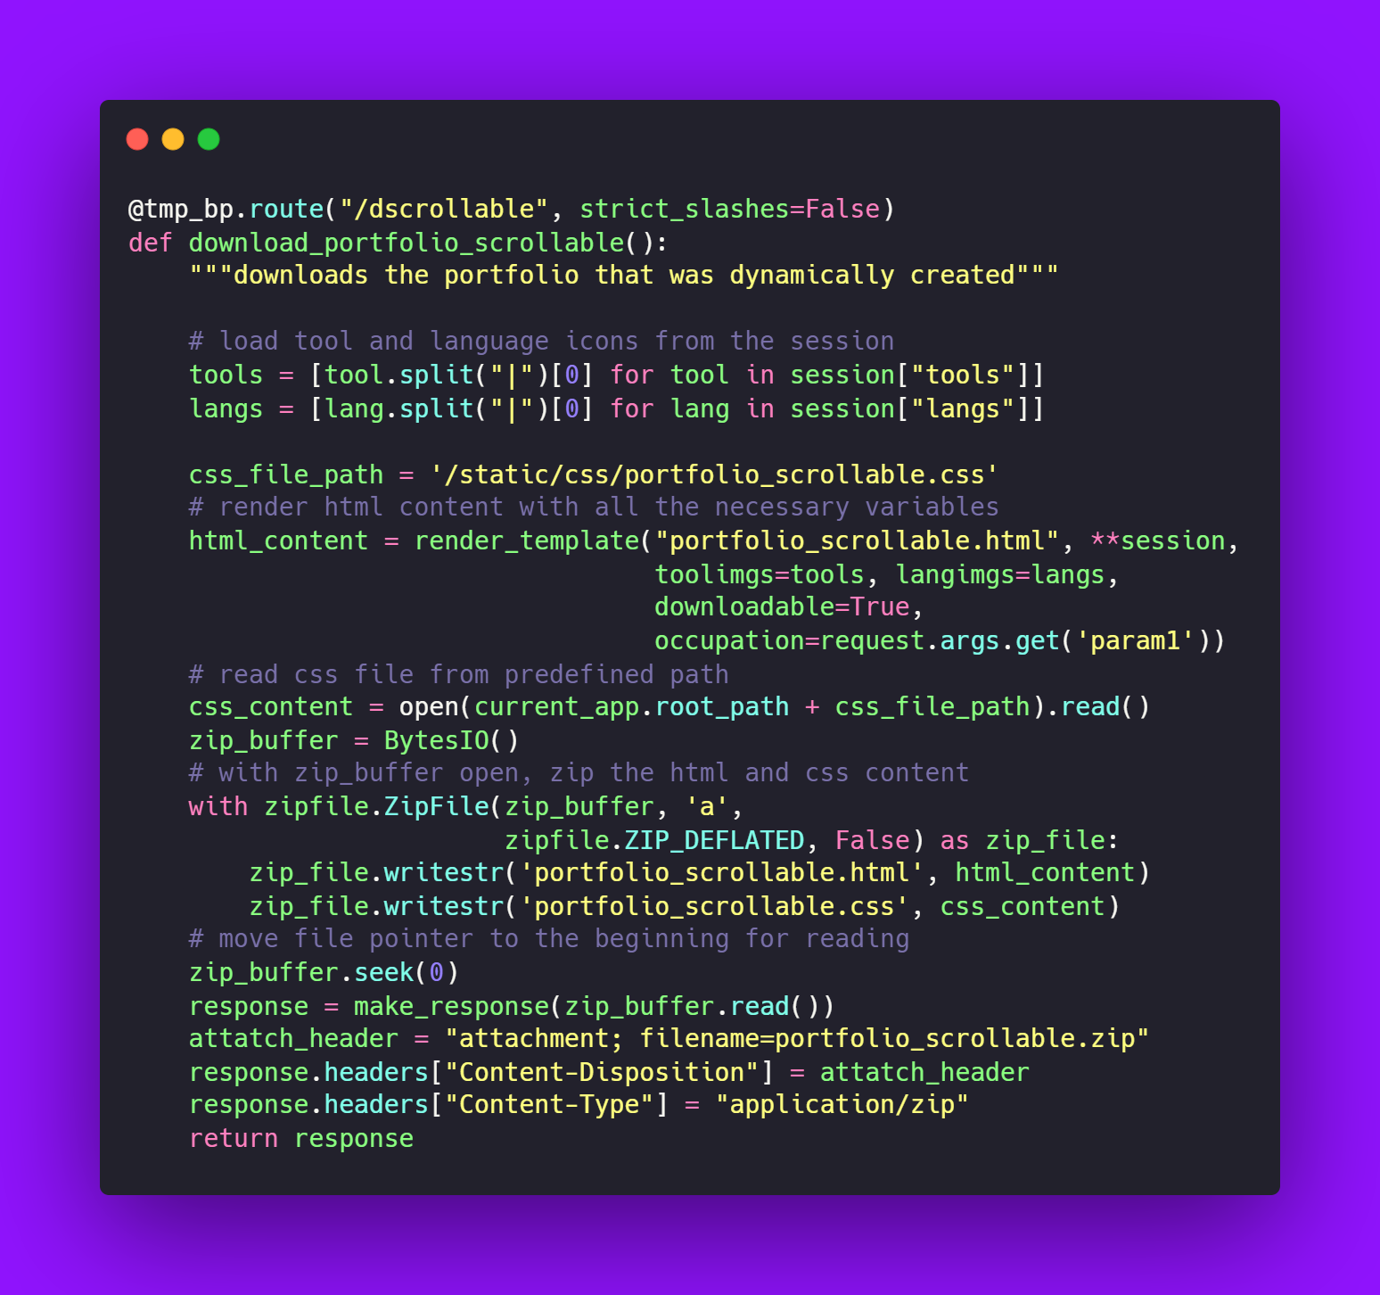
Downloading Templates

Slide 10
Project Timeline
 | November |  |  |  |  |  |  | December
Objective | 17 | 19 | 21 | 23 | 25 | 27 | 29 | 01 | 03 | 05 | 07 | 13
Setting Up Database and Reading 3rd party tool Documentation
Coding Utility classes to interact with backend API
Setting Up API endpoints and integrating all the backend code
Login, Signup, Dashboard and Settings Page
Designing Templates and Populating Them
Backend Testing with Python unittest
Landing Page, Blog Post, Documentation and Presentation

Slide 11
Challenges
Technical
Non-Technical
GraphQL API
Integration
Downloading Templates
Power Outages
Stress & Time management

Slide 12
Thanks!
bradleygilden
@coma.script
@comascript
For freelance inquiries please contact me at:
bradleygilden@mail.com

